Slide 1
Computer Vision Fundamentals
Lecture 2 - Part 1
Introduction to MATLAB

Slide 2
Contents
What is MATLAB?
Key Concepts
Using MATLAB
Using variables
Typecasting
WHOS and WHO
TIC TOC timer

Slide 3
What is MATLAB?
Matlab is a data analysis and visualization tool which has been designed with powerful support for matrices and matrix operations.
As well as this, Matlab has excellent graphics capabilities, and its own powerful programming language.
One of the reasons that Matlab has become such an important tool is through the use of sets of Matlab programs designed to support a particular task.
These sets of programs are called toolboxes, and the particular toolbox of interest to us is the image processing toolbox.

Slide 4
Key Concepts
A Matlab function is a keyword which accepts various parameters, and produces some sort of output: for example a matrix, a string, a graph or figure. Examples of such functions are sin, imread, imclose.
Matlab’s standard data type is the matrix—all data are considered to be matrices of some sort. Images, of course, are matrices whose elements are the grey values (or possibly the RGB values) of its pixels. Single values are considered by Matlab to be matrices, while a string is merely a matrix of characters; being the string’s length.

Slide 5
Using MATLAB
For this course, we will use OCTAVE online compiler for hustle free coding on MATLAB.
Access link: https://octave-online.net/

Slide 6

Using variables
DON’T FORGET TO HIT ‘ENTER’ AFTER EACH COMMAND
>> a=5^(7/2)
a = 279.5085
>> b=sin(pi/9)-cos(pi/9)
b = -0.5977

Slide 7
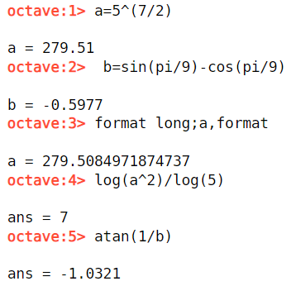
Typecasting
DON’T FORGET TO HIT ‘ENTER’ AFTER EACH COMMAND
>> format long;a,format
a = 2.795084971874737e+02
>> log(a^2)/log(5)
ans = 7
>> atan(1/b)
ans = -1.0321

Slide 8

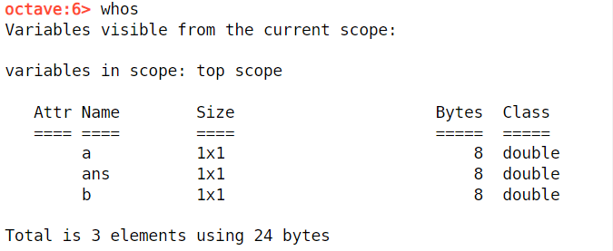
WHOS and WHO
If you are using a windowed version of Matlab, you may find a Workspace item in the View menu. This lists all your currently defined variables, their numeric data types, and their sizes in bytes. To open the workspace window, use the View menu, and choose Workspace. The same information can be obtained using the whos function:

Slide 9

TIC TOC timer
tic starts a stopwatch timer, and toc stops it and prints out the elapsed time in seconds
>> tic , for i = 1 : 10 ^ 6 , sin ( i ) ; end , toc

Slide 10
Thankyou

